Slide 1

WBL Machine Vision
Presentation by Anand Low Hong Ren

Slide 2
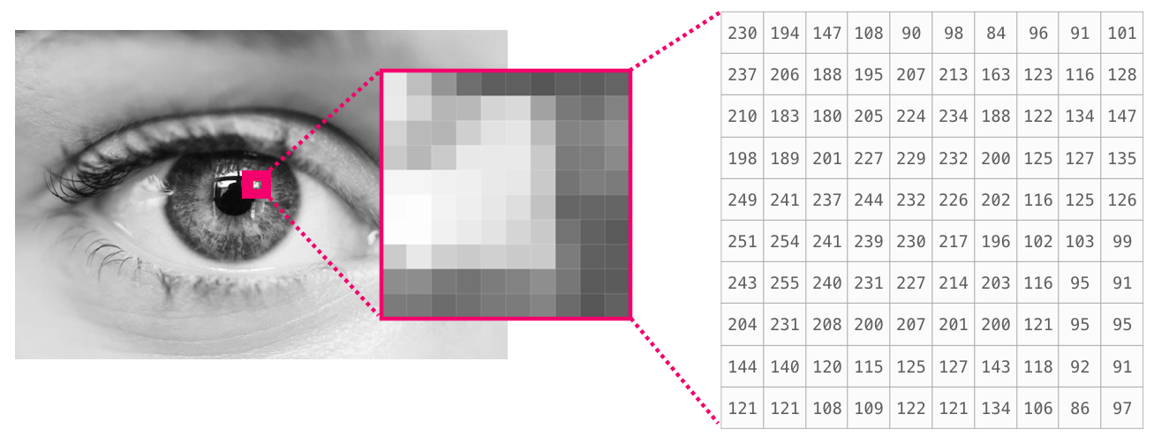
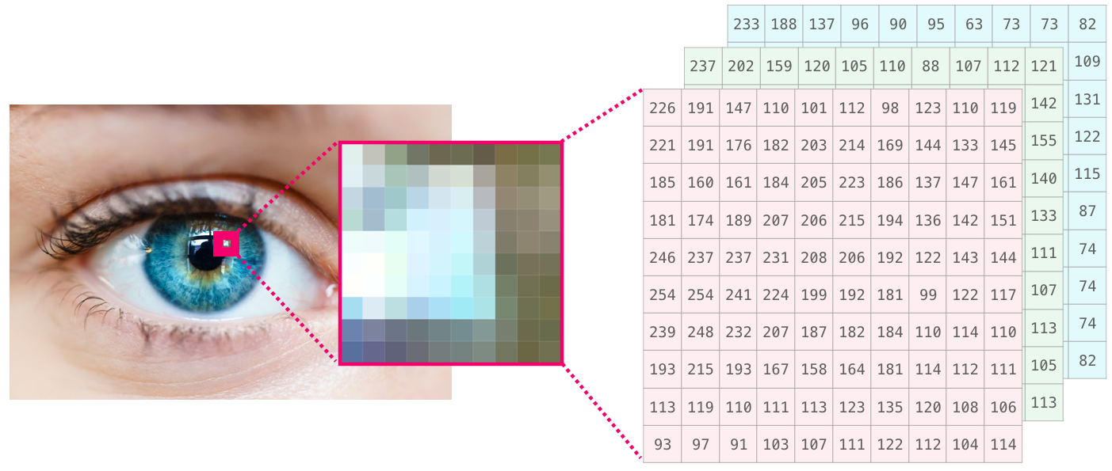
Basic Digital Imaging Concepts
Image consists of pixels
Each pixel carries a number which determines its colour
A pixel of a 8-bit grayscale image range from 0-255.
A colour image has a 3-D array while a grayscale image has a 2-D array.

Slide 3
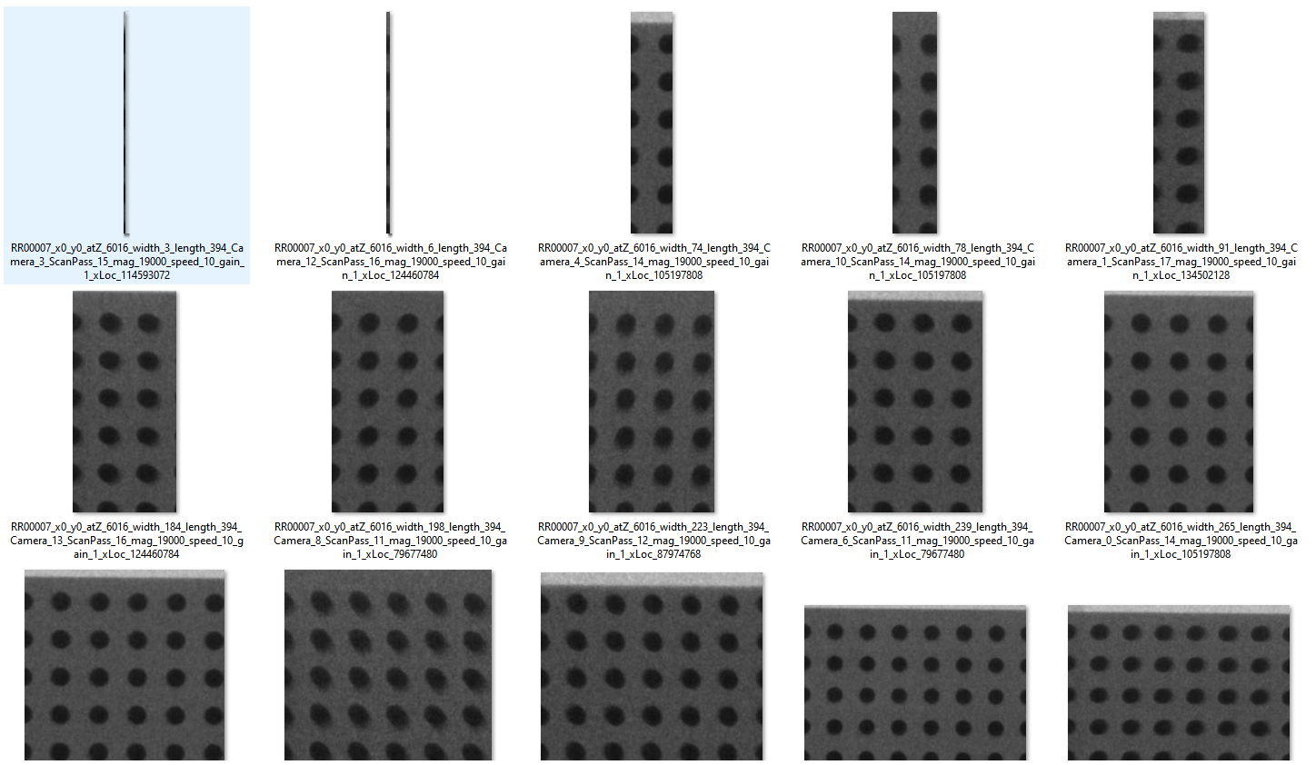
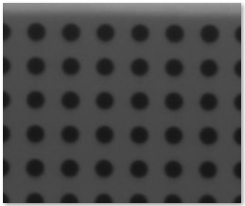
Assignment 1 Image Reconstruction
Objective:
1. To combine multiple (41) images with different sizes to reconstruct one complete image
Reconstructed Image

Slide 4
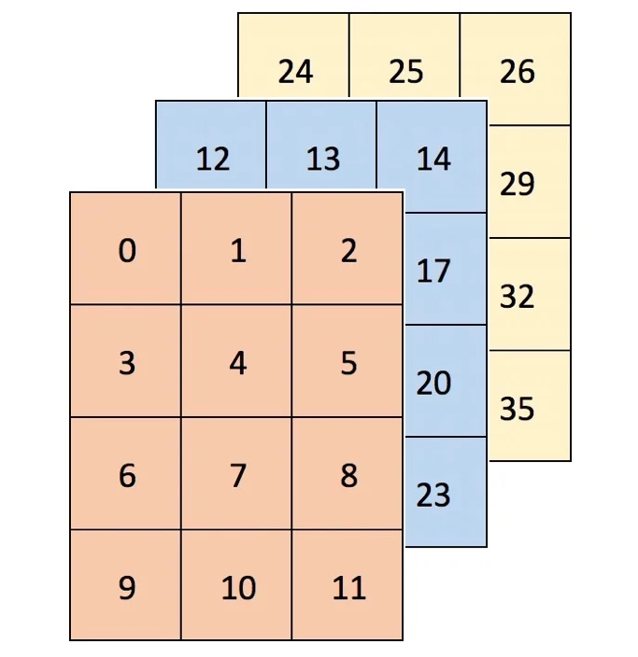
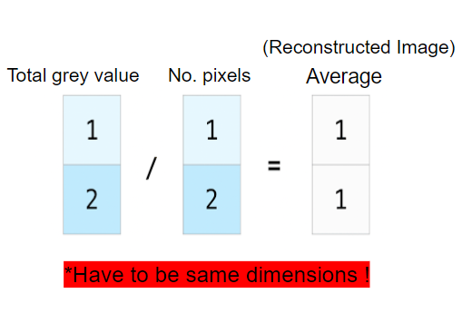
Solutions
Get the sum!
Q1: How is the reconstruction made?
A1: The concept
get the average pixel value/gray value.
Array must be same size
The arrays of each images are added:
The first array is the cumulative of the grey values (0 -255)
The second array is the cumulative of the number of pixels overlapped

Slide 5
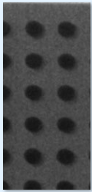
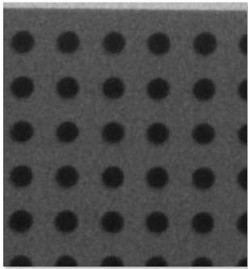
Solutions cont.
(0,0)
Q2 How to deal with different size images and offsets?
A2 The pictures are copied onto an empty array before calculation
For 1st example, the image starts at (0,0) and has a width of 184 px and length of 394 px.
For 2nd example, the image starts at (104, 0) and has a width of 365 px and length of 394px.
The empty array dimensions is the dimensions of the largest image + offsets
(184, 394)
(104, 0)
(469, 394)
Notes:
The empty array must be big enough to accomodate the dimensions of the image and the offsets created by the x and y coordinates.

Slide 6
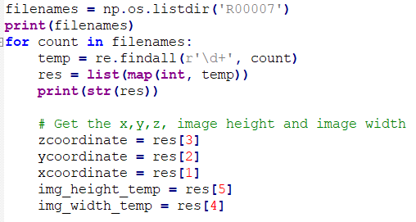
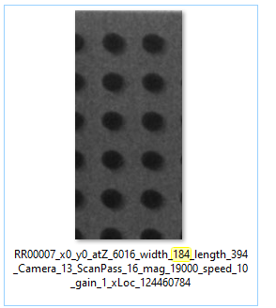
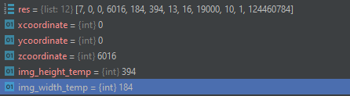
Extracting important details from filename
This code snippet goes through the entire filename and extracts all the numbers
The numbers are stored in a list and can be accessed for calculation purposes.

Slide 7
Program flow
Extract x, y, z, width and height from the file name
Find the maximum dimension of the images to determine dimension for empty array
The 2 empty arrays are created.
Output image is the result of total grey value array divide by no. of pixels overlapping
One array accumulate the total grey value, while another array accumulate the no. of pixel overlapping.
The images are pasted onto the empty arrays

Slide 8
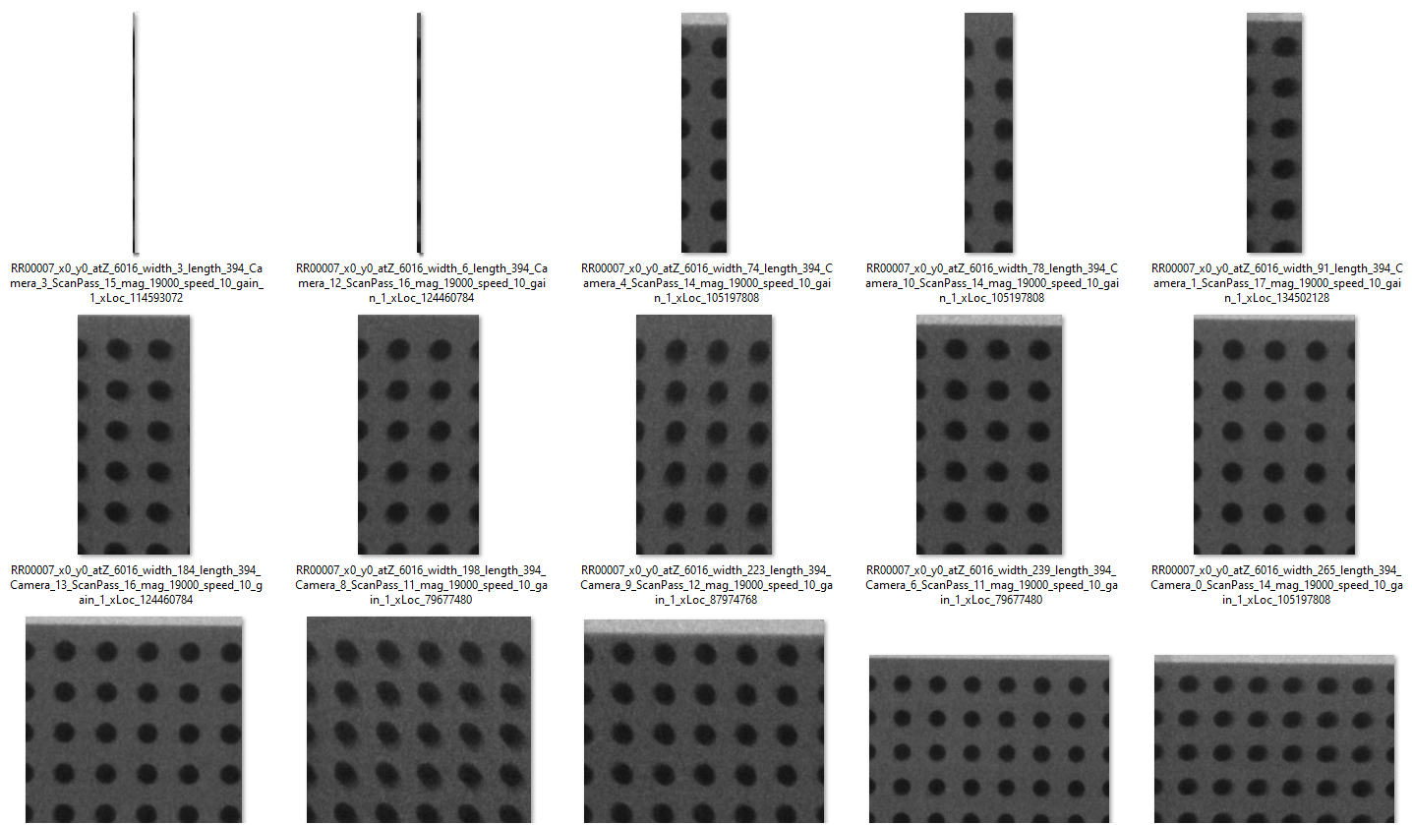
Results
Initial Photos

Slide 9
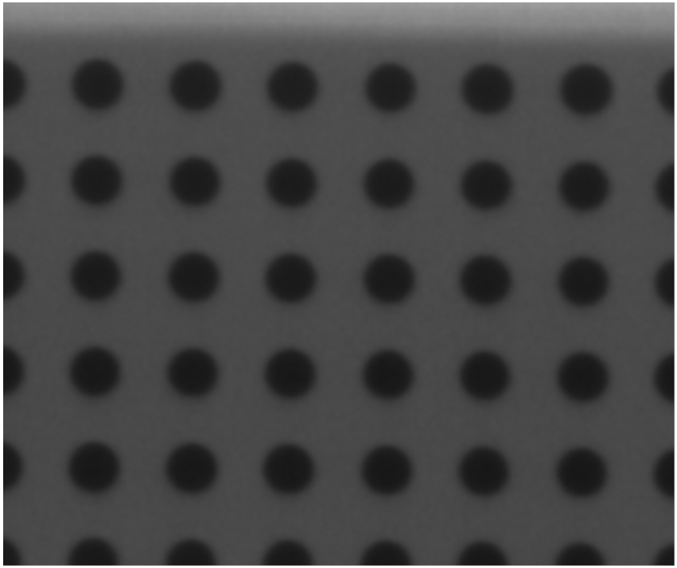
Results cont.
Final Output Image

Slide 10
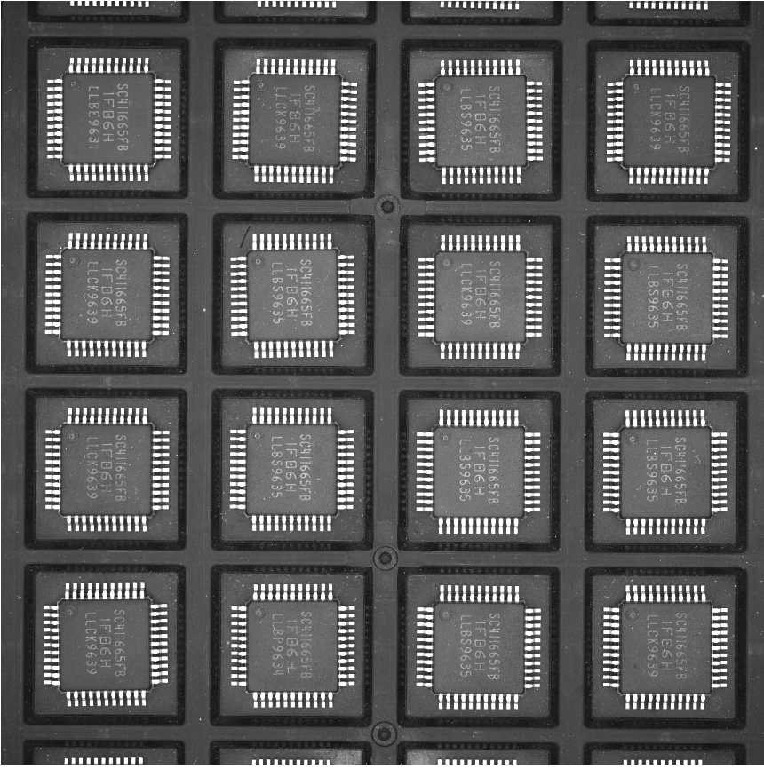
Assignment 2 Image Segmentation
Objective:
Define ROI and apply thresholding to segment the characters on the chip and the leads
Apply different thresholding algorithms and compare the results

Slide 11
Solutions
Q1: How to process each component individually?
A1:
1. The x and y- coordinates of the top left and bottom right corner of the chip is located through ImageJ.
2. A nested for loop is used to offset the ROI so that each chip is processed individually one after the other.
3. The chips are processed row by row.
1
2
3
4
5
6
7
8
9
10
11
12
13
14
15
16

Slide 12
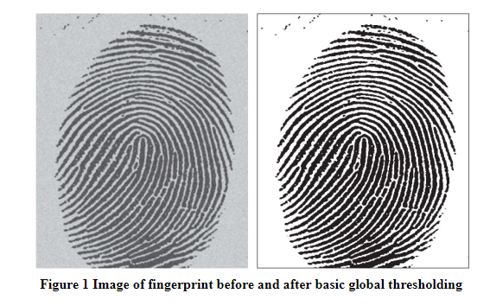
Solutions cont.
Q2: How does the segmentation works?
A2:
The key concept to segmentation is thresholding.
selecting a threshold value
any pixel value is above the threshold value is set to a binary 1
value is equal or below the threshold value is set to a binary 0
There are many types of thresholding algorithms.
Notes:
This basic binary thresholding works for images with intensity distributions of the objects and background pixels are sufficiently distinct.

Slide 13
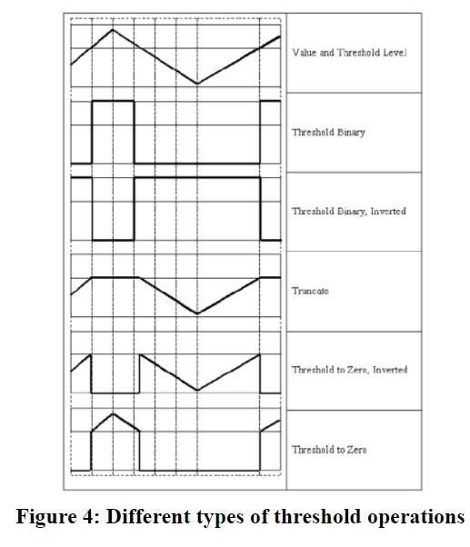
Thresholding in OpenCV
OpenCV Python comes with 6 global thresholding functions which are binary, truncate, threshold to zero and Otsu’s thresholding algorithm.
OpenCV Python also includes adaptive local thresholding which thresholds a pixel based on nearby pixels rather than the whole image.
Notes:
As you can see, the signal here represents the grey value of the pixels. The red line represents the threshold value manually set by the user. As said before, if the grey value exceeds the threshold value it will be set to a binary 1, in the case of 8-bit grayscale image is a grey value of 255. The pixels with grey value less than the threshold value will be set to grey value of 0.

Slide 14
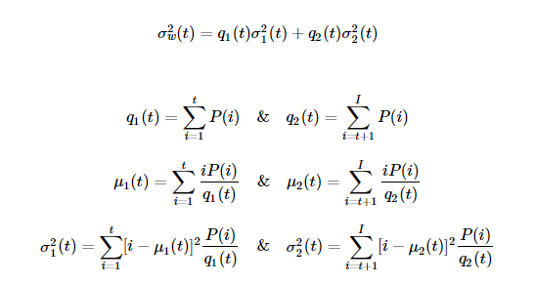
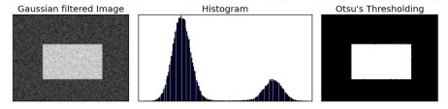
Otsu’s binarization
Otsu's method avoids having to choose a value and determines it automatically.
Otsu's algorithm tries to find a threshold value (t) which minimizes the weighted within-class variance given by the relation.
It actually finds a value of t which lies in between two peaks such that variances to both classes are minimal.
Notes:
variance measures how far a set of numbers is spread out from their average value.

Slide 15
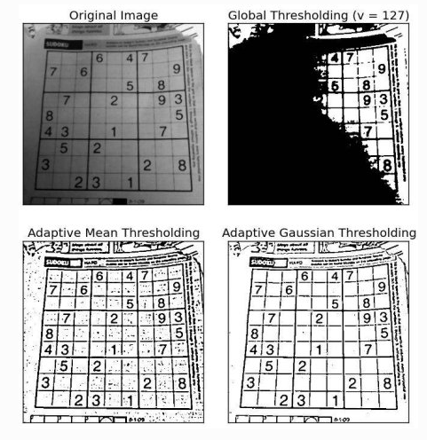
Adaptive thresholding
Global thresholding may not be good when image has different lighting conditions in different areas.
The algorithm calculate the threshold for a small region of the image.
we get different thresholds for different regions of the same image

Slide 16
Adaptive thresholding in OpenCV
2 Types:
cv2.ADAPTIVE_THRESH_MEAN_C : threshold value is the mean of neighbourhood area.
cv2.ADAPTIVE_THRESH_GAUSSIAN_C : threshold value is the weighted sum of neighbourhood values where weights are a gaussian window.
The parameters needed to be determined by the user are the Block Size and C.
Block Size - the size of neighbourhood area
C - a constant which is subtracted from the mean calculated.

Slide 17
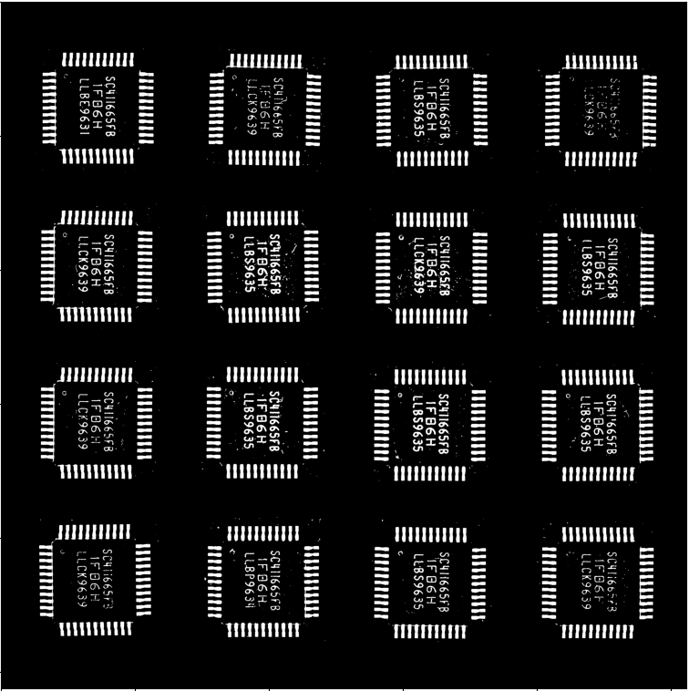
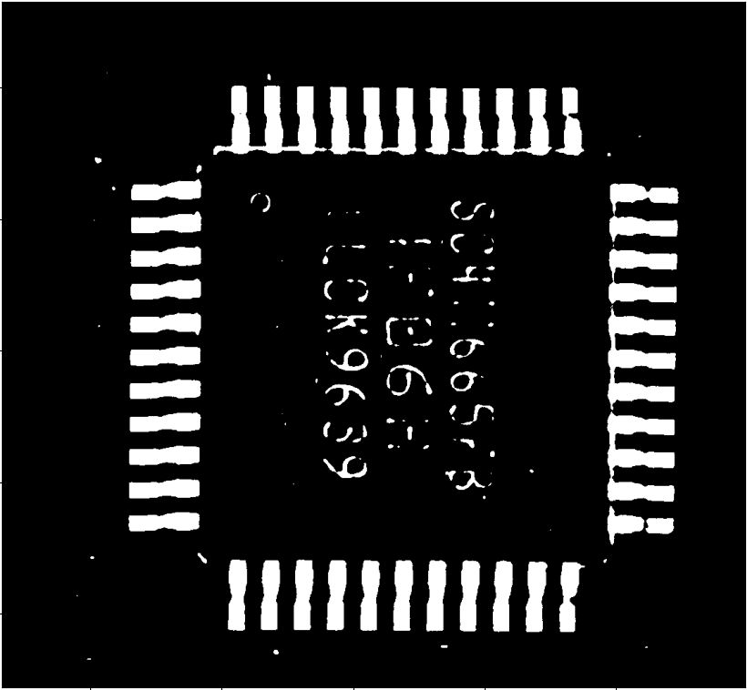
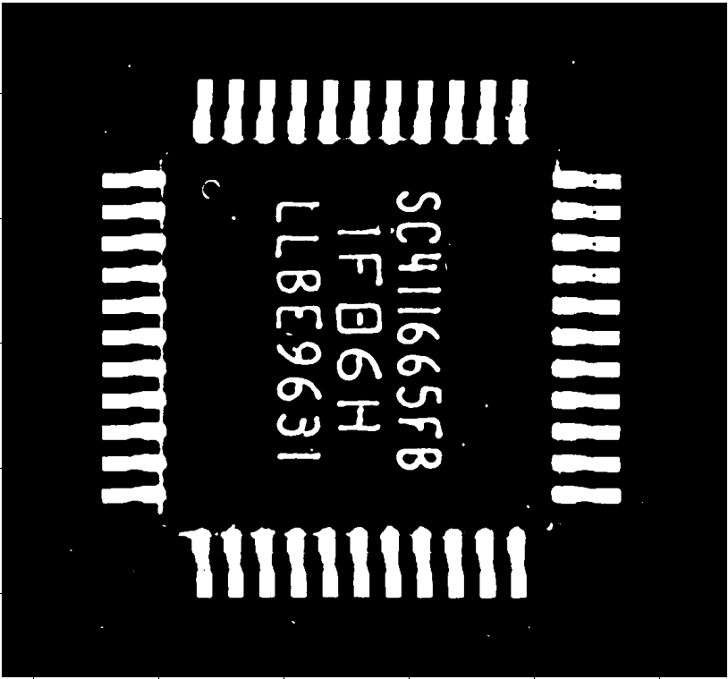
Results ( v = 127)
Global Binary Thresholding
Very clear sample
Character can’t be seen properly
Notes:
Note: A4 Chip
Dust and noise

Slide 18
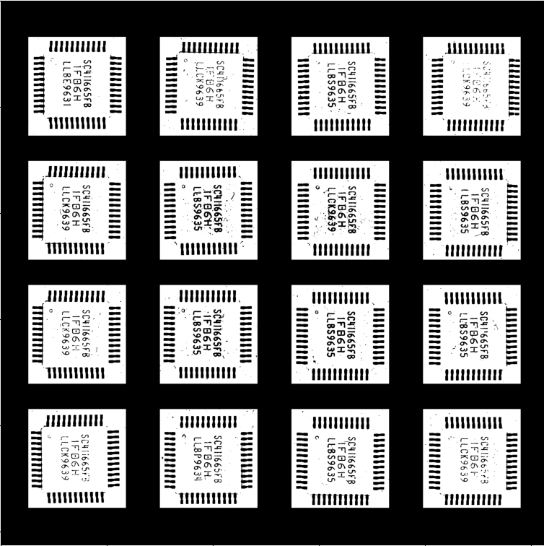
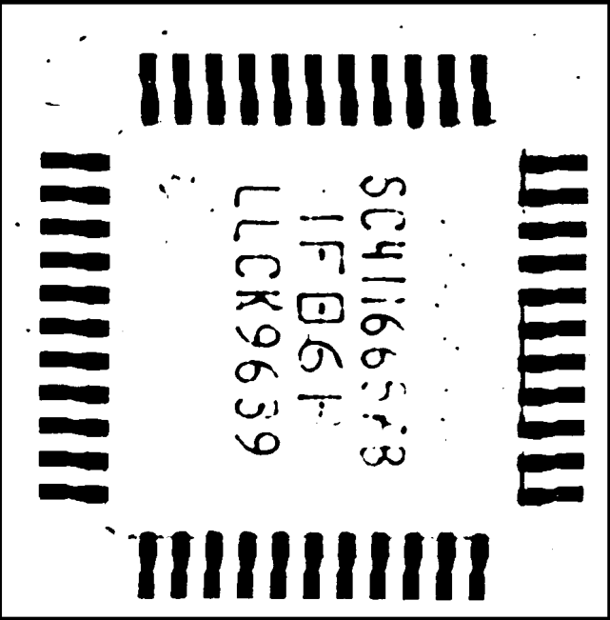
Results cont.
Global binary inverse thresholding

Slide 19
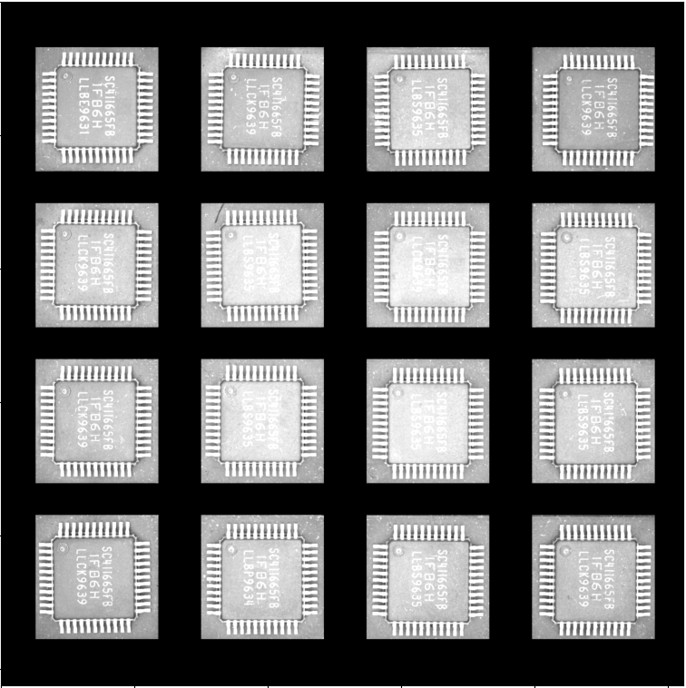
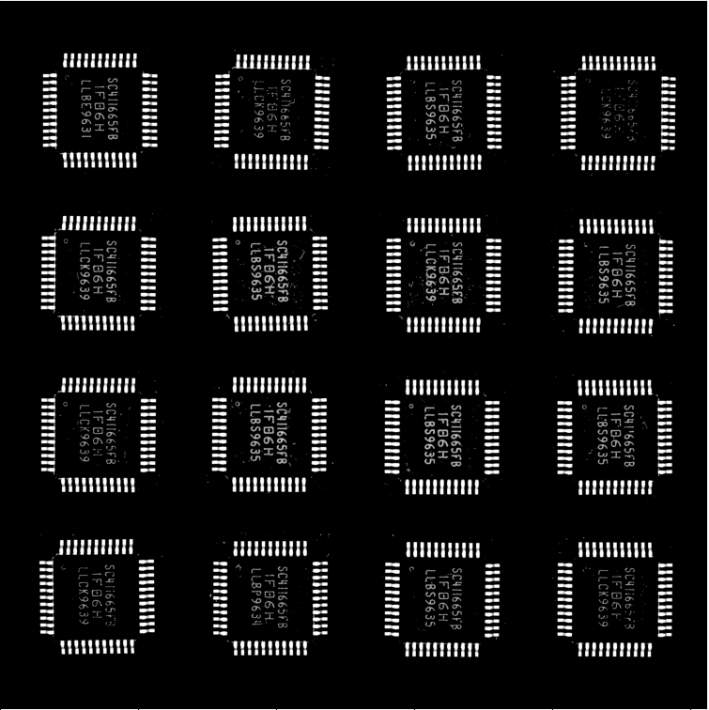
Global truncate thresholding
Global to zero thresholding

Slide 20
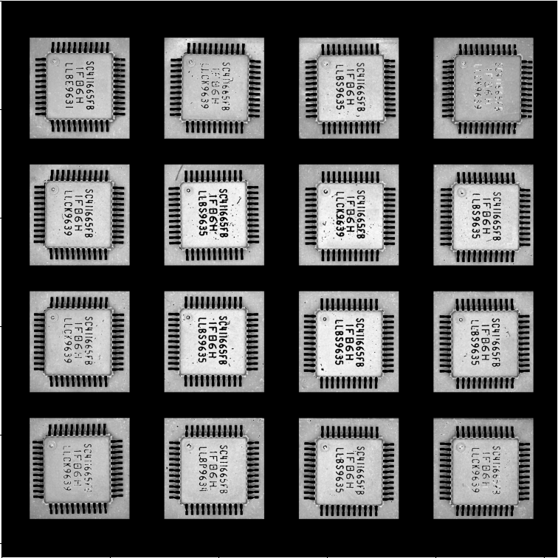
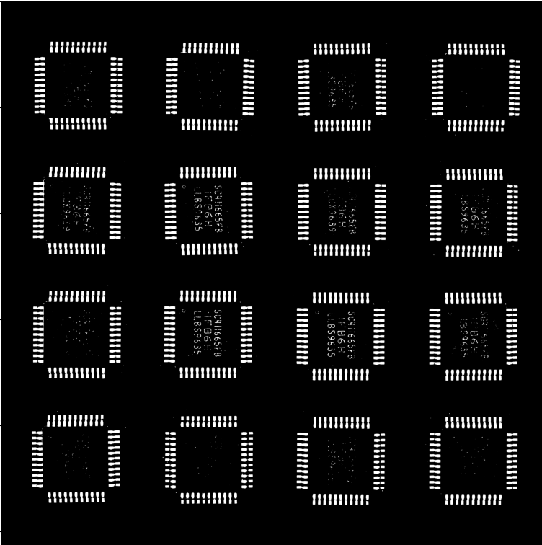
Global to zero inverse thresholding
Global Otsu’s binarisation thresholding

Slide 21
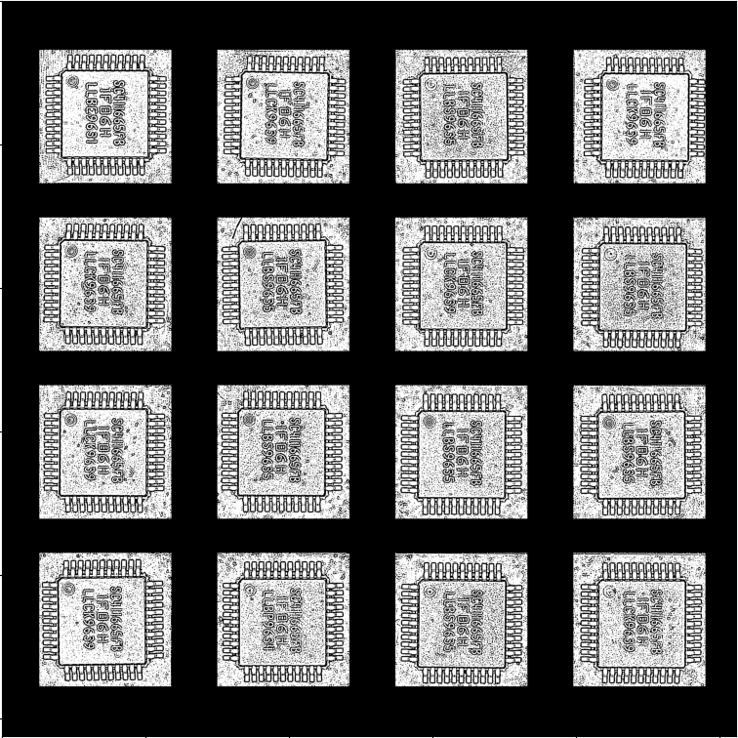
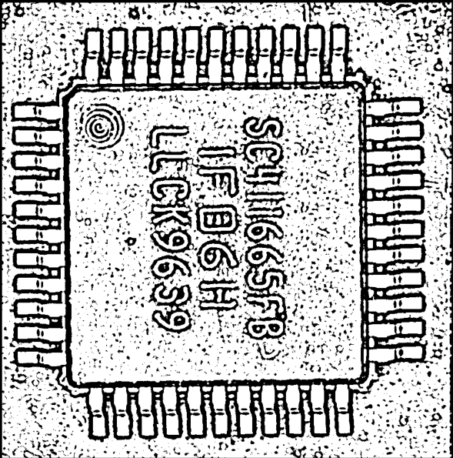
Adaptive mean thresholding

Slide 22
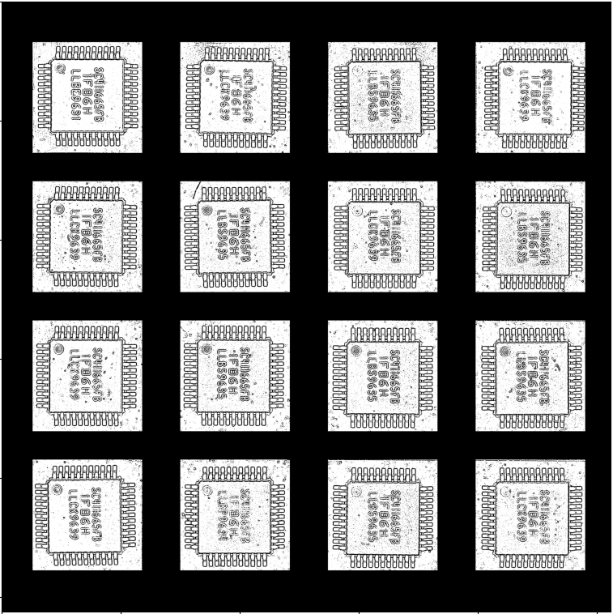
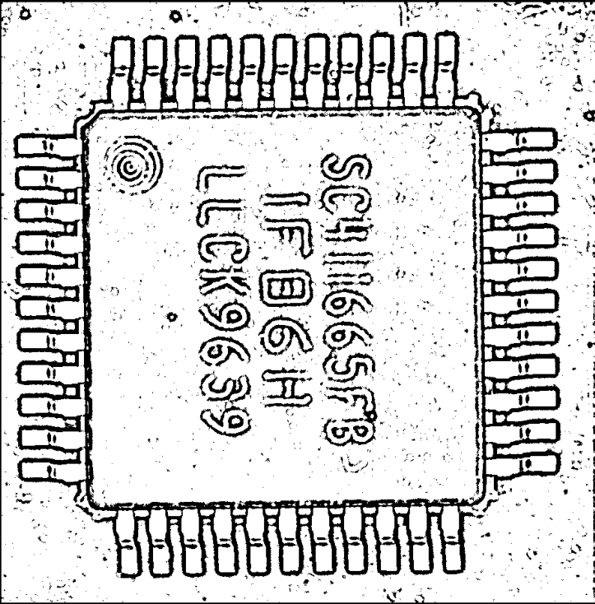
Adaptive Gaussian mean thresholding

Slide 23
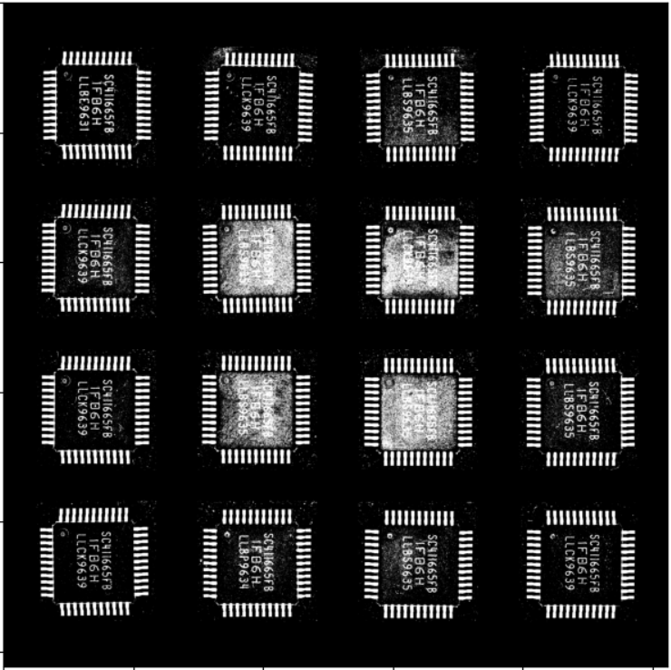
Results cont. ( v = 115)
In this example, the threshold value is set too low.
If the threshold is set too high the characters cannot be segmented properly.
If the threshold is set too low, the brighter lit images will have problems segmenting the characters.

Slide 24
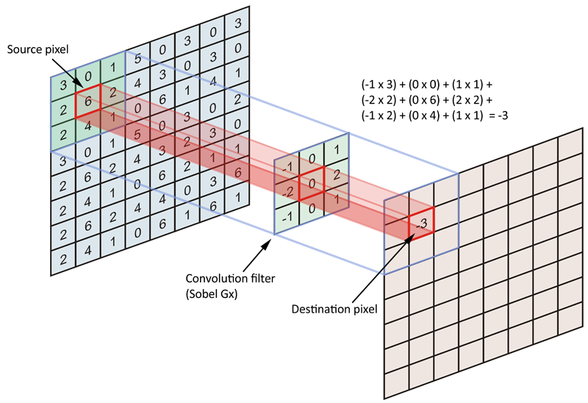
Image Smoothing
One way to reduce noise from image is by applying blur or image smoothing.
Each pixel value is recalculated based on the kernel given.
The resultant image is a blurrer version of the original image.
In OpenCV there are 3 functions which blurs the image with preset kernels.
The blur algorithm available are Gaussian blur, median blur and bilateral filtering.

Slide 25
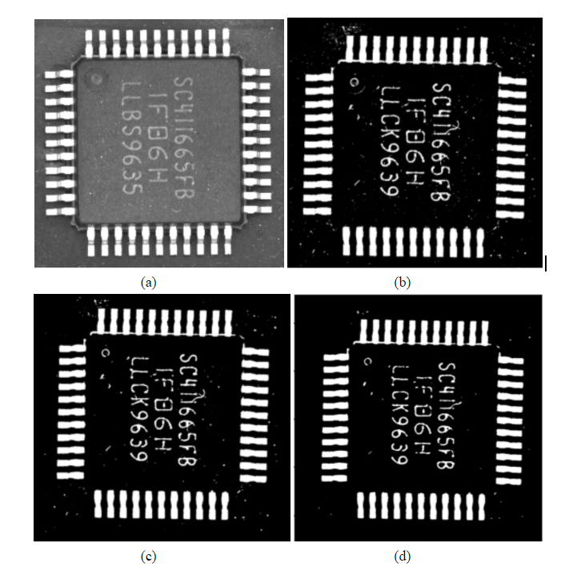
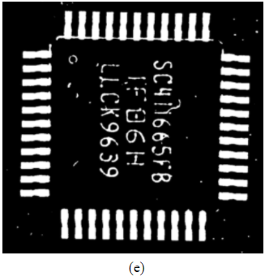
(a) original image of A2 chip
(b) binary threshold A2 chip
(c) binary threshold with Gaussian blur of kernel size 5
(d) binary threshold with median blur of kernel size 5
(e) binary threshold with bilateral filtering

Slide 26
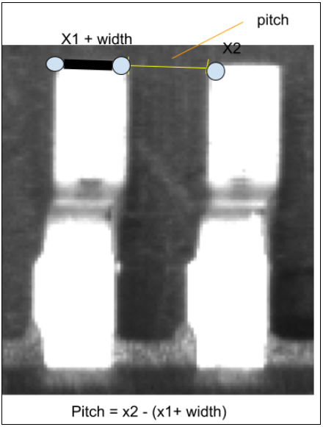
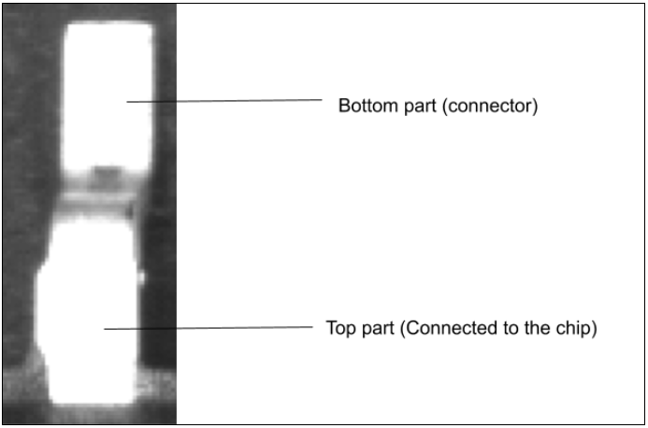
Assignment 3 Measurement using blob detection
Objective:
Find the edges of the leads of the chip
Calculate the length and width of the leads.
Calculate the pitch between leads.

Slide 27
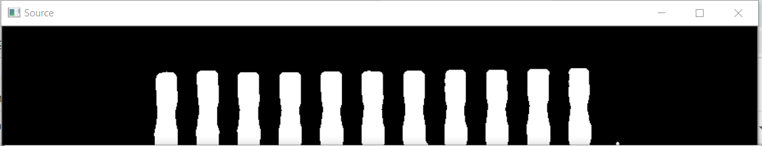
Solution
Q1: How to identify the leads?
A1:
First, image segmentation is used first to differentiate the leads from the background.
OpenCV findContour() function is used to find any object on the black background.
Small objects are assumed to be noise or dust are removed from the image.

Slide 28
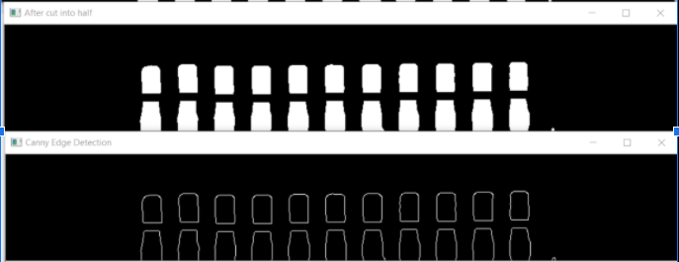
4. Canny edge detection filter is applied onto the image.

Slide 29
Solution cont.
Q2: How to measure and calculate the length and width of each lead?
A2:
OpenCV findContour() function is used to find the edges of the leads.
OpenCV boundRect() function bounds a rectangle to the leads.
The length and width of the rectangle = length and width of the lead.

Slide 30
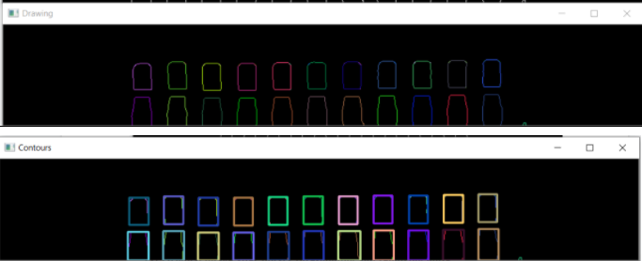

Slide 31
Solutions cont.
Q3: How to measure and calculate the pitch?
A3:
1. Since we know the width, X1 and X2 which is returned by the OpenCV boundRect() function.
2. The equation to calculate pitch can be deduced.

Slide 32

Program flow
Apply median blur and binary global thresholding
Remove small noise and dust
Apply Canny edge detection filter
Bound rectangle to leads
Pitch is calculated.
Notes:
Make it shorter and include important things only

Slide 33
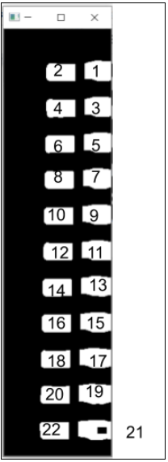
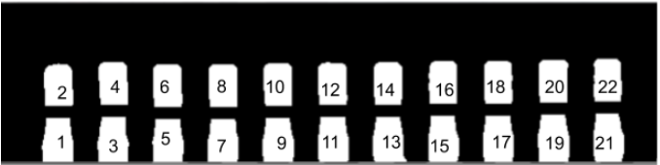
Results
Pitch: 26 px
Pitch: 24 px
Height: 40 px
Width: 26 px
Height: 34 px
Width: 46 px
Lead label for top row
Height: 52 px
Width: 32 px
Height: 25 px
Width: 42 px
Lead label for left row
Notes:
Label more organise

Slide 34

Assignment 4 Frequency Domain Filter using FFT
Objective:
Learn the fundamentals of fourier transform and the frequency domain.
Apply knowledge of frequency domain to filter artifacts out of images.

Slide 35

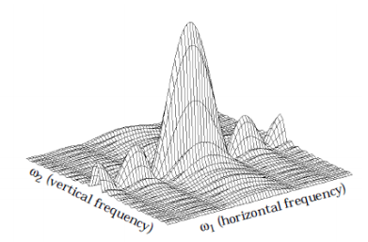
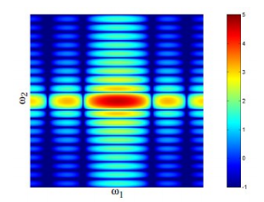
Difference between spatial and frequency domain
Spatial Domain:
Deal with images as it is.
The value of the pixels of the image change with respect with scene.
Frequency domain:
Deal with rate at which the pixel values are changing in the spatial domain.
Notes:
In the frequency or Fourier domain, the value and location are represented by sinusoidal relationships that depend upon the frequency of a pixel occurring within an image.

Slide 36


Frequency Domain
High Frequency = high rate of change
Low frequency = low rate of change

Slide 37
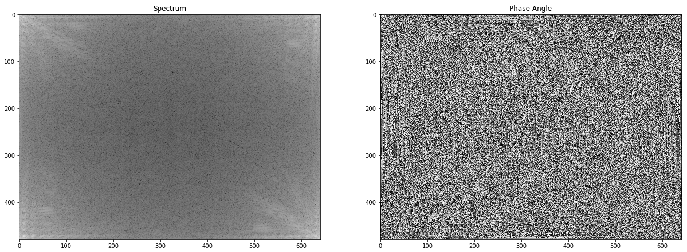
Why use Fast Fourier Transform?
Digital Image is discrete
Discrete Fourier Transform is too slow
Output of FFT is a complex number array

Slide 38
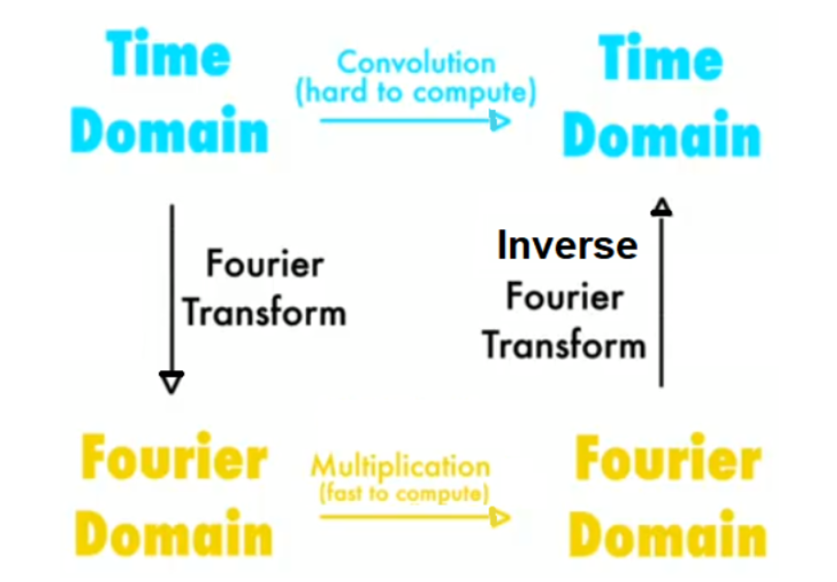
Application of Fourier Transform and Frequency Domain
The convolution theorem states that convolution in the spatial domain is equivalent to multiplication in frequency domain.
Convolution generally takes a longer time to process because it is more complex than simple multiplication in the frequency domain.
Frequency domain can be used to blur or sharpen photos.

Slide 39
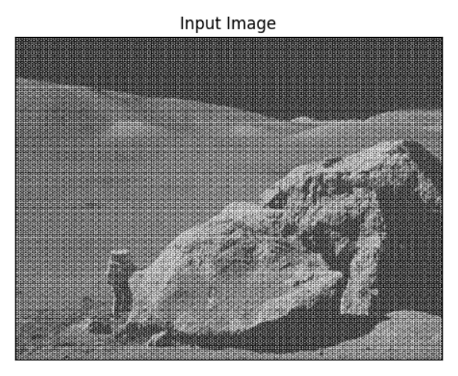
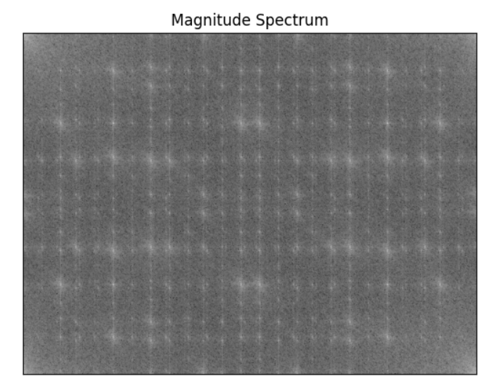
Part 1
Low Frequency
High Frequency

Slide 40
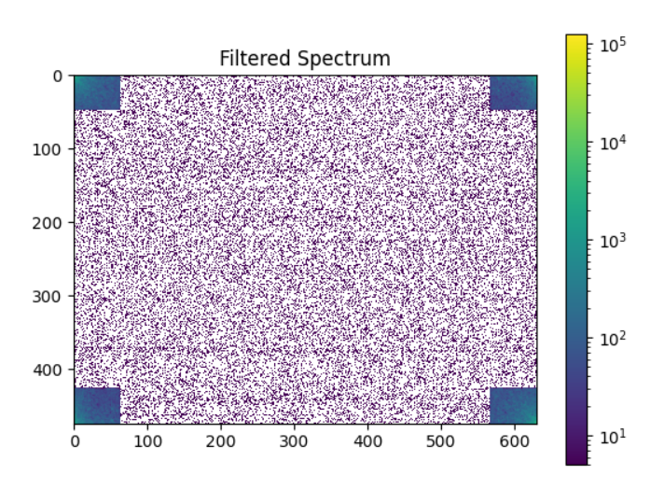

Results Part 1

Slide 41


Part 2

Slide 42

Part 2 cont.
2D FFTSHIFT

Slide 43


Part 2 cont.
Cropping certain area removes contents from that range of frequencies.

Slide 44

Results Part 2

Slide 45


Other examples

Slide 46

Other examples cont.

Slide 47

Assignment 5 Image processing research on image stack for 3D rendering
Objective:
Familiarize with Volumetric Analysis and Rendering Tool
Improve bad 3D render with Python

Slide 48


Volume rendering
A set of techniques which projects a 2D projection of a 3D data set.
3D data set is a stack of 2D slice images.
2D slice images obtained by CT or MRT scanner.

Slide 49

Stack of 2D slice images in board V
Notes:
gif

Slide 50


Original 3D render (threshold 0 -135)
Problem 1: the less contrast balls cannot be seen properly.

Slide 51



Original 3D render (threshold 0- 205)
Problem 2: lumps sticking the balls together

Slide 52

Solution
Create a Mask to define ROI
Choose image with clearest ball
Apply Gaussian blur and adaptive mean thresholding
Remove unwanted blob
Use dilation (morphological transform) to increase ROI

Slide 53







After apply mask to define ROI
1
2
3
4
Notes:
Arrow label

Slide 54

Solution cont.
2. Apply Histogram Equalisation
It is a method that improves the contrast in an image, in order to stretch out the intensity range

Slide 55







After apply Histogram Equalization
1
2
3
4

Slide 56


Solution cont.
3. A better method is CLAHE, Contrast Limited Adaptive Histogram Equalization.
CLAHE operates on small regions in the image, called tiles, rather than the entire image
The neighboring tiles are then combined using bilinear interpolation to remove the artificial boundaries.

Slide 57






After apply CLAHE
1
2
3
4

Slide 58

Learning Outcome
The fundamentals of digital image processing
Image Enhancement in spatial and frequency domain
Image Segmentation
Morphological Image Processing

Slide 59

Q&A Session

